Slide 1
Airplane Risk Assessment
Flatiron DS Flex Phase 1 Project
Abigail Campbell
Notes:
[ ] introduction
[ ] business context
[ ] data
[ ] process steps
[ ] results & business application (recommendations)
[ ] evaluation & future improvement ideas
[ ] contact information

Slide 2
Airplane Risk Assessment
We are considering expanding into aircraft transportation, but what are the risks involved?
Which airplane applications are the most dangerous? Instructional, Aerial
Which airplane manufactures have the best safety record? Boeing, Airbus
What size of airplane is the most reliable? 2+ engines
Notes:
Your company is expanding in to new industries to diversify its portfolio. Specifically, they are interested in purchasing and operating airplanes for commercial and private enterprises, but do not know anything about the potential risks of aircraft. You are charged with determining which aircraft are the lowest risk for the company to start this new business endeavor. You must then translate your findings into actionable insights that the head of the new aviation division can use to help decide which aircraft to purchase.

Slide 3
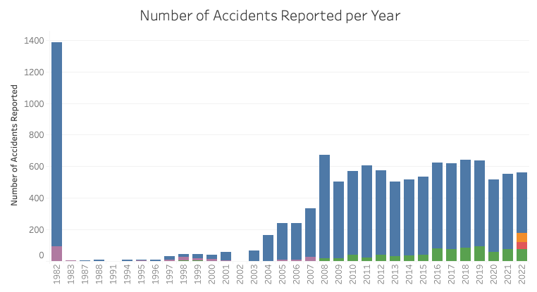
Data Set
National Transportation Safety Board Accident Data
Reported aircraft accidents
Within the US and international waters
Filtered to only include relevant data
27,580 relevant reports
1982 – 2022
Notes:
Highlight important components
Vis with distribution about
Number of instances
Important variables, some descriptive stats

Slide 4
What Information is in this data set?
Airplane information
Make
Model
Location information
Accident location
Injury information
Fatalities
Minor injuries
Engine type
Number of engines
Weather conditions
Severe injuries
No injuries
Flight information
Phase of flight
Purpose of Flight
Airport name
Latitude
Longitude
Notes:
Highlight important components
Vis with distribution about
Number of instances
Important variables, some descriptive stats

Slide 5
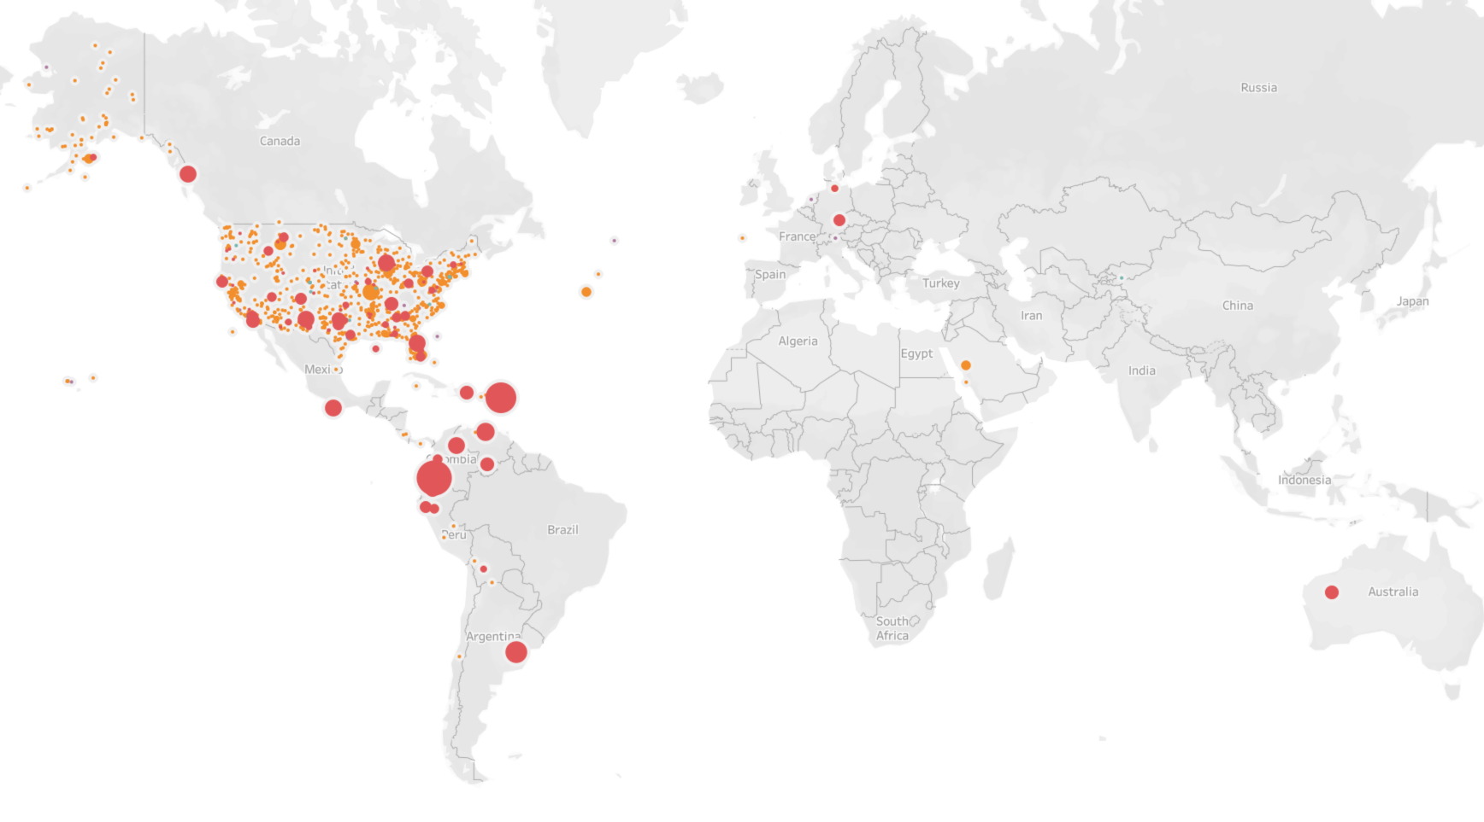
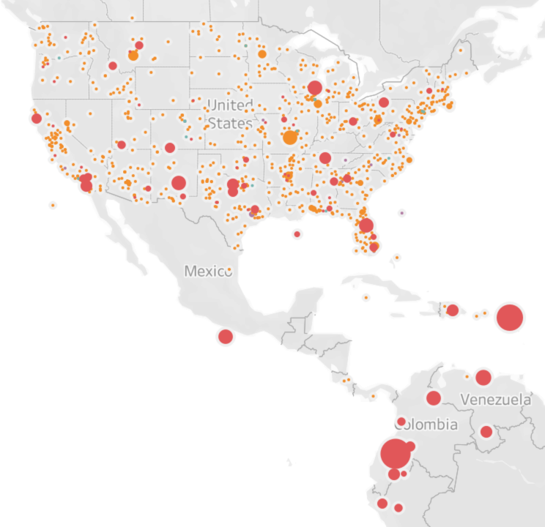
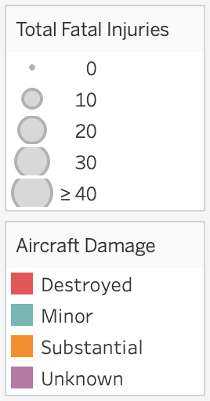
Where are these Accidents occurring?
Most Accident Reports occurred within the Americas
Notes:
We have data for the Americas.
Most in the us – come concentration around the coasts
Size = n fatalities
Color = aircraft damage
Most crashes are in visibile weather conditions
Biggest crashes are further south

Slide 6
How do we ensure this data is relevant and accurate?
Filter out irrelevant data
Remove or replace incomplete data
Standardize data format
Investigate for trends
Notes:
Irrelevant data:
Non airplane crashes
Personal flights
Military filghts
27,580 relevant reports

Slide 7
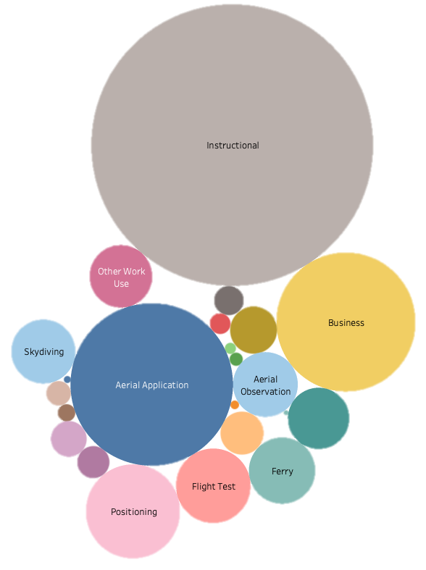
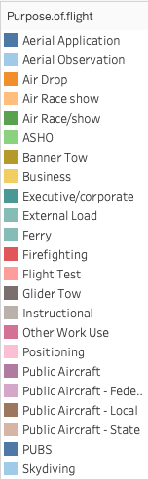
What were the airplanes doing?
Most common flight purposes that resulted in accidents:
1. Flight Instruction
2. Aerial Application (Crop Dusting)
3. Business

Slide 8
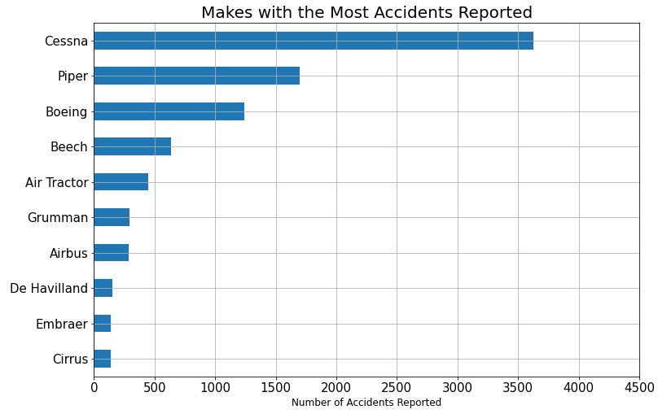
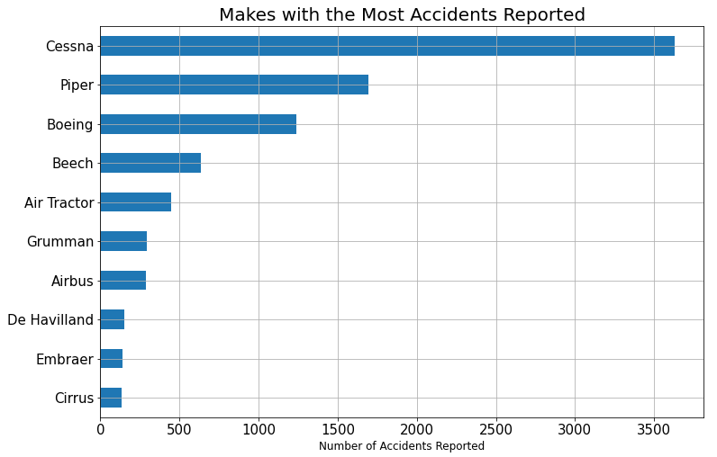
Which Airplane Manufacturers crashed the most?
Top 3 Makes:
Cessna
Piper
Boeing
Notes:
Reads as a who’s who in the airplane manufacturing world
top 10 manufactureres according to https://assetsamerica.com/aircraft-manufacturers/
According to wikipedia: "Big Three" in field of general aviation manufacturing:
- Cessna, Beechcraft, Piper
Northrup Grumman: large military contractor
Air Tractor: agriculture planes
Cirrus: single engine light aircraft
De Havilland: utility aircraft (working)

Slide 9
Which Airplane Manufacturers crashed the most?
Top 5 Commercial Makes:
1. Boeing (USA)
2. Airbus (Netherlands)
3. Embraer (Brazil)
4. Bombardier (Canada)
5. Comac (China)
Top 5 Private Makes:
1. Airbus Corporate Jets (France)
2. Boeing Business Jets (USA)
3. Bombardier Business Aircraft (Canada)
4. Beechcraft (USA)
5. Cessna (USA)
General Aviation “Big 3”:
1. Cessna
2. Beechcraft
3. Piper
Notes:
Reads as a who’s who in the airplane manufacturing world
top 10 manufactureres according to https://assetsamerica.com/aircraft-manufacturers/
According to wikipedia: "Big Three" in field of general aviation manufacturing:
- Cessna, Beechcraft, Piper
Northrup Grumman: large military contractor
Air Tractor: agriculture planes
Cirrus: single engine light aircraft
De Havilland: utility aircraft (working)

Slide 10
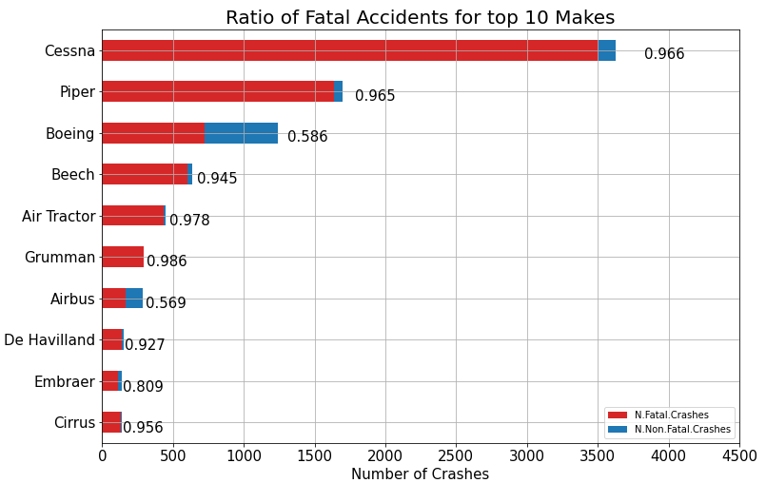
How many of these accidents resulted in fatalities?
# fatal crashes
total crashes
Fatality ratio =
Most Makes:
fatality ratios above 0.9
(>90% fatal)
Boeing and Airbus: fatality ratios below 0.6
(<60% fatal)

Slide 11
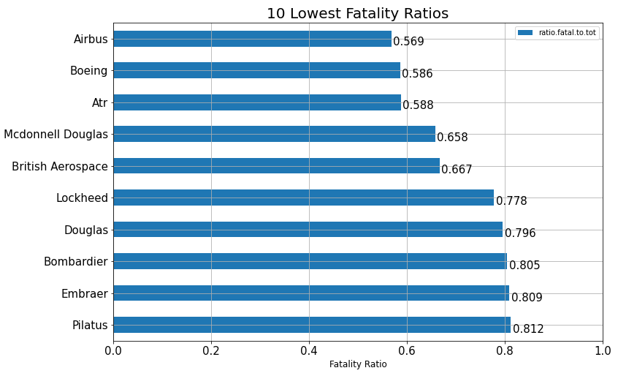
Which Airplane manufactures have the lowest fatality rate?
Boeing and Airbus:
Large, reputable manufactures
Lowest fatality ratios

Slide 12
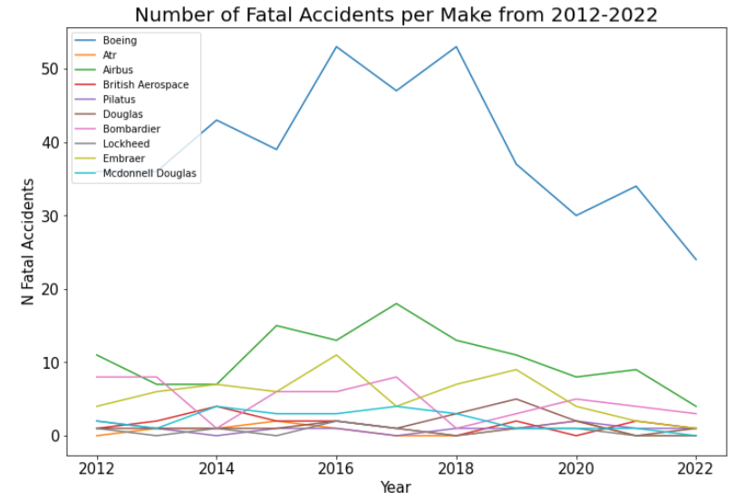
Which makes have made the most Safety improvements?
Improvements over the last 10 years
Looking at the 10 makes with the lowest fatality ratio
Overall Trend: Not much improvement
Boeing: Significant reduction in fatalities since 2018
Airbus: Reduction in fatalities sins 2017
Notes:
While Boeing and Airbus have the most fatal accidents – they also have a lot of planes in the sky
Boeing and Airbus are showing decreases in fatal accidents, while other manufactures aren’t

Slide 13
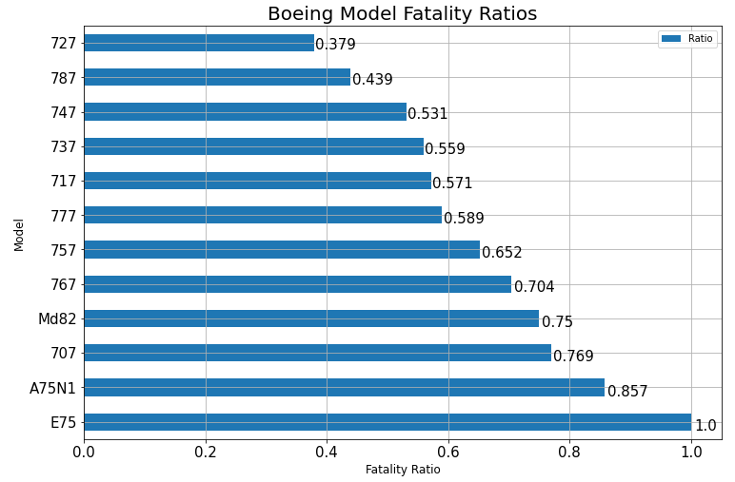
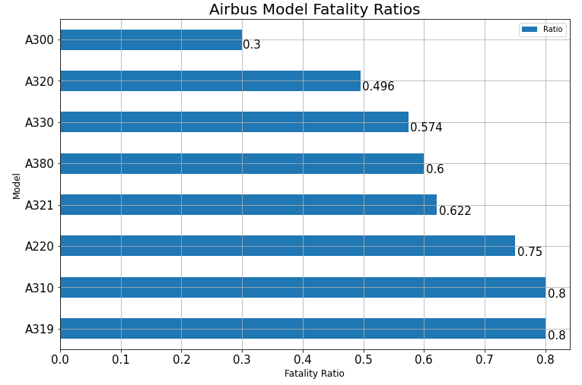
Which Boeing and airbus models have the lowest fatality ratios?
Each Make has 2 models with fatality ratios below 0.5:
Boeing: 727, 787
Airbus: A300, A320

Slide 14
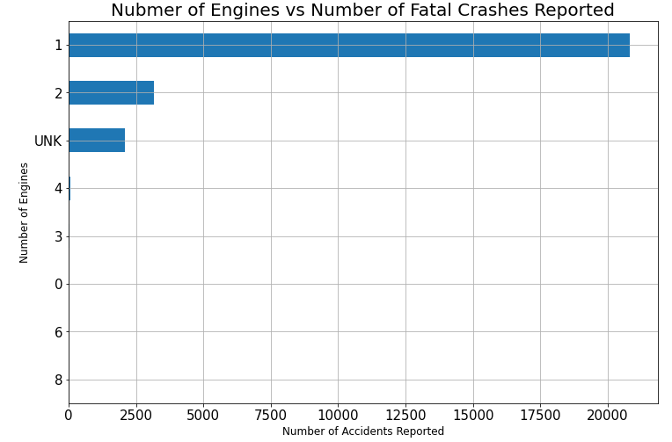
Number of Engines that Produce the most Fatalities
Shorthand for Airplane size
Small, single engine planes crashes produce the most fatalities

Slide 15
Conclusions
Avoid Instructional and Aerial Applications
Boeing and Airbus have the best safety record
Best models: Boeing 727 & 787, Airbus A300 & A320
Avoid single engine planes

Slide 16
What now?
Determine Airplane Requirements
What cargo will we be transporting?
What size of plane is necessary?
Individual Manufacturer Due Diligence
Which manufacture has the best crash / total flight ratio?
Are specialty planes required?
Which manufacturer has the most planes in the sky?

Slide 17
Contact information
Abigail Campbell
abbycampbell0@gmail.com
(801) 541-2771

